Slide 1
Sprint 8
drifts analysis summary
gwloggeR update

Slide 2
Agenda
gwloggeR update
Test framework
Issue #47
Summary drift analysis
Multi comparison (one vs. all) vs Reference comparison (one vs KNMI)
Barometer overview: best to worst
Barometer altitude analysis
Next step proposals
detect_drifts() function

Slide 3
gwloggeR
Update

Slide 4
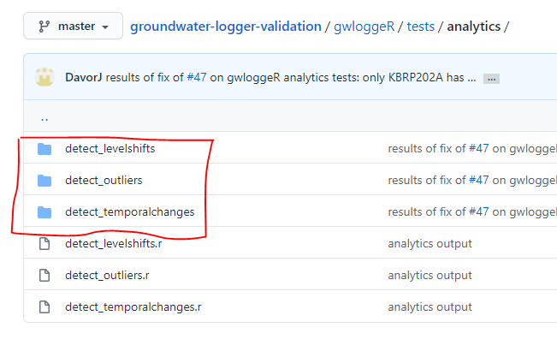
gwloggeR update Testing framework
For each function and each INBO/Geotech file:
Result
Image
Metadata
→ Testing framework makes sure that the package functions produce the same results as before, and only fix that what needs to be fixed.

Slide 5
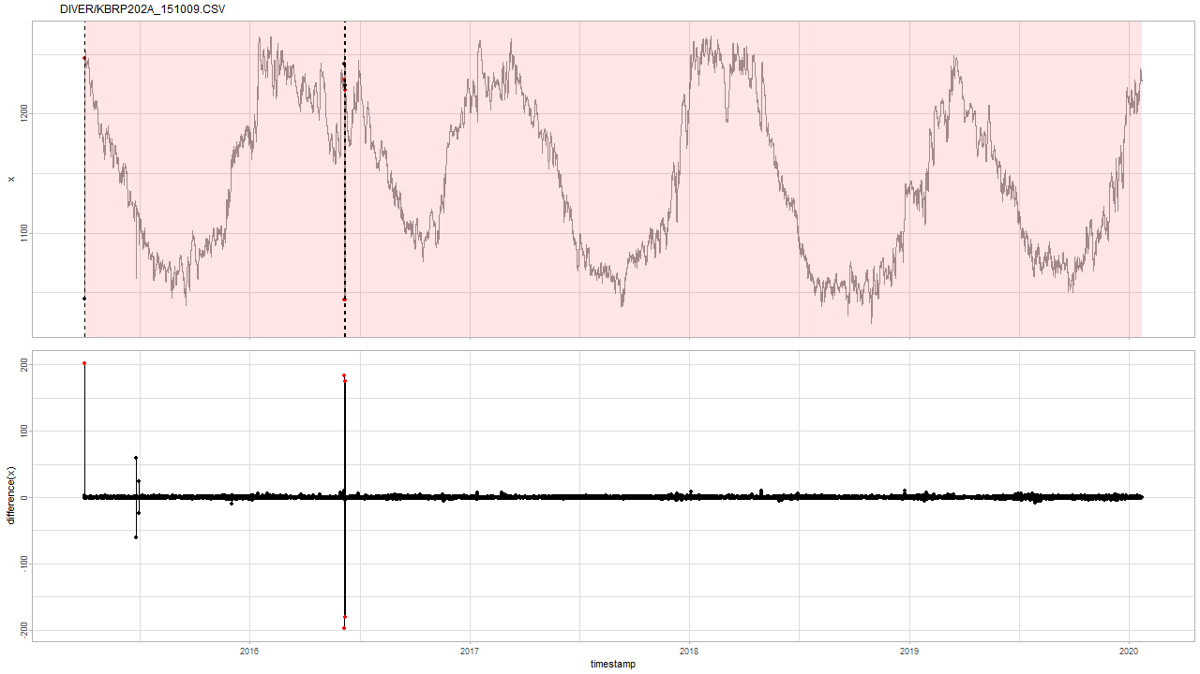
gwloggeR update Issue #47
Fix of issue #47 has only effect on this specific case.

Slide 6
Summary drift analysis
Multi- and reference comparison analysis
Barometer overview: best to worst

Slide 7
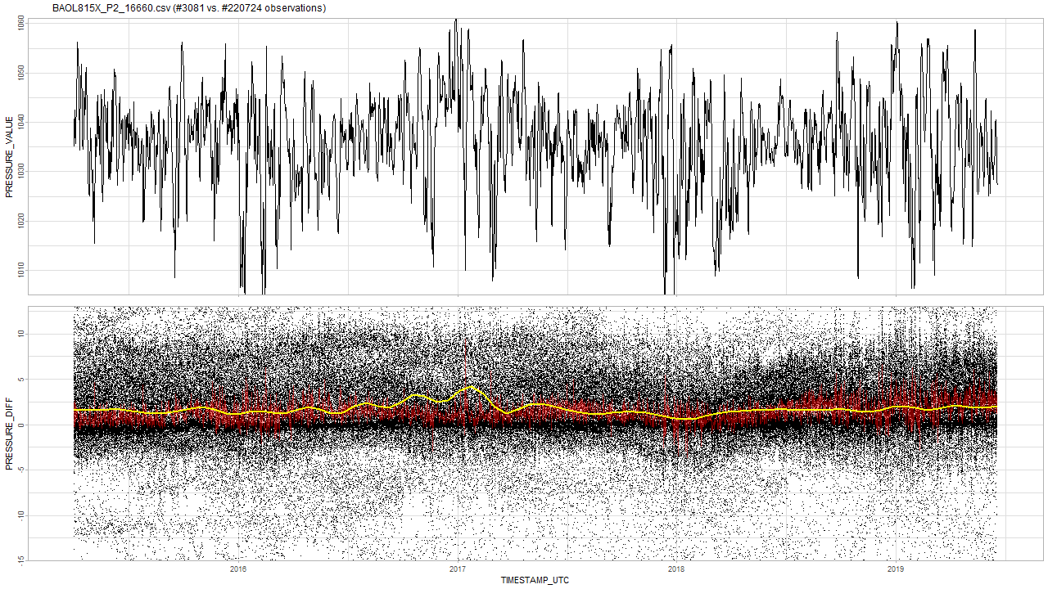
Multi comparison: good One barometer vs all the rest
Notes:
Zie voor theorie naar slides sprint 7.
Je verwacht een stationair rode lijn: vast gemiddelde met ruis errond.

Slide 8
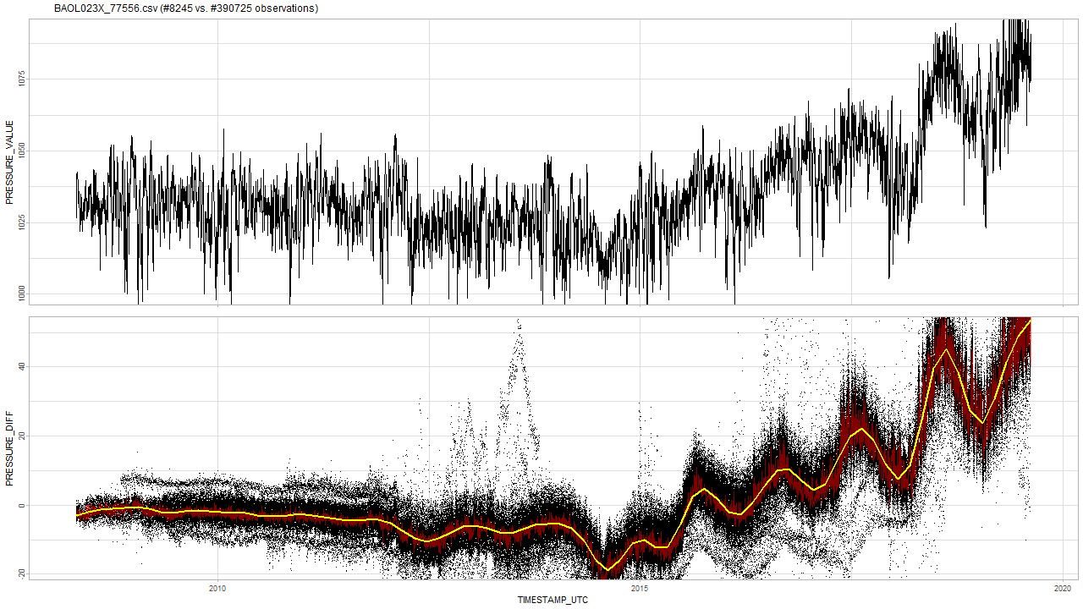
Multi comparison: bad One barometer vs all the rest
Notes:
De gemiddelde van de rode lijn is hier niet stationair, maar oscilleert en daalt zelfs.

Slide 9
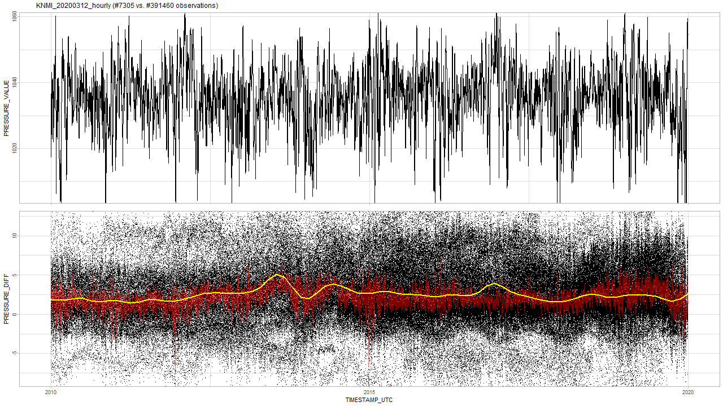
Multi comparison: KNMI (Westdorpe) KNMI barometer assessment based on multi comparison analysis
No drift and SD analysis suggests performance of an average INBO barometer.

Slide 10
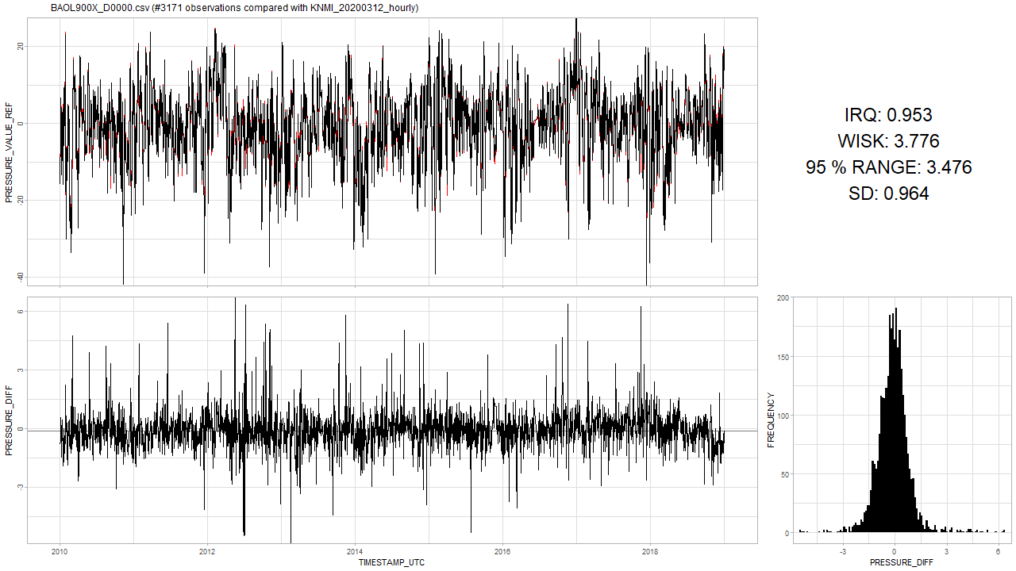
Reference comparison: good One barometer vs KNMI reference barometer

Slide 11
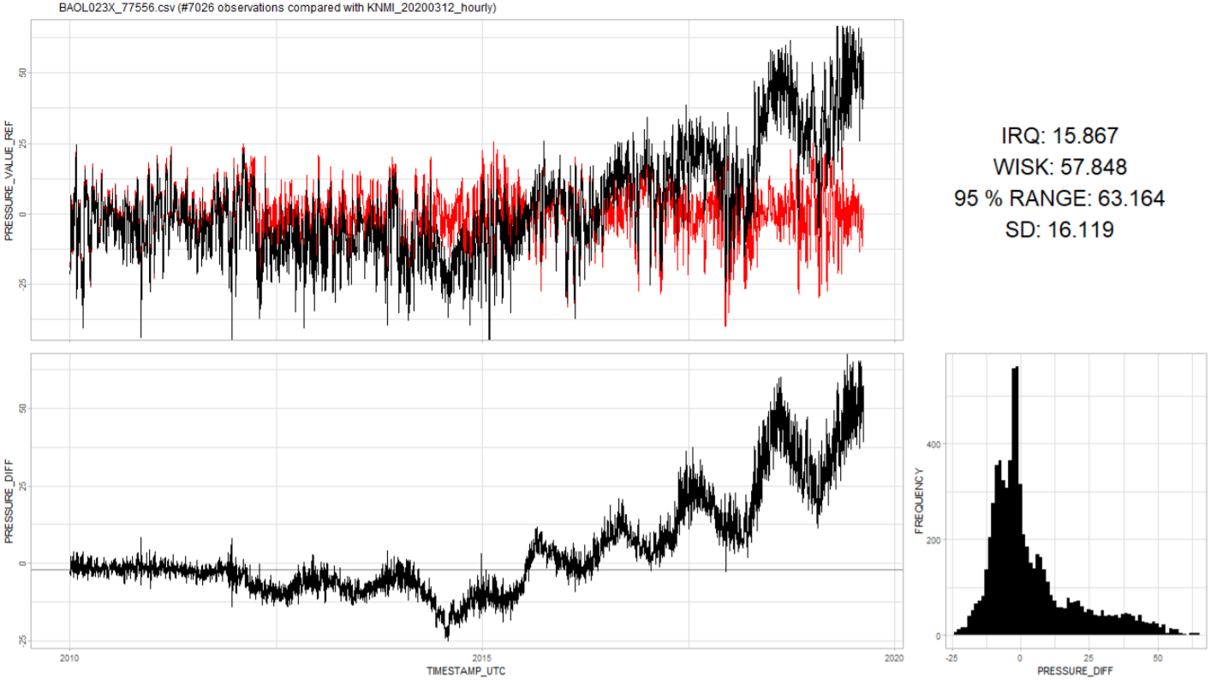
Reference comparison: bad One barometer vs KNMI reference barometer

Slide 12
Multi or reference comparison? Which analysis method is better?
Pretty much the same results
A possibly better question is: which one is more practical?
Need one good barometer.
Need lots of barometers.

Slide 13
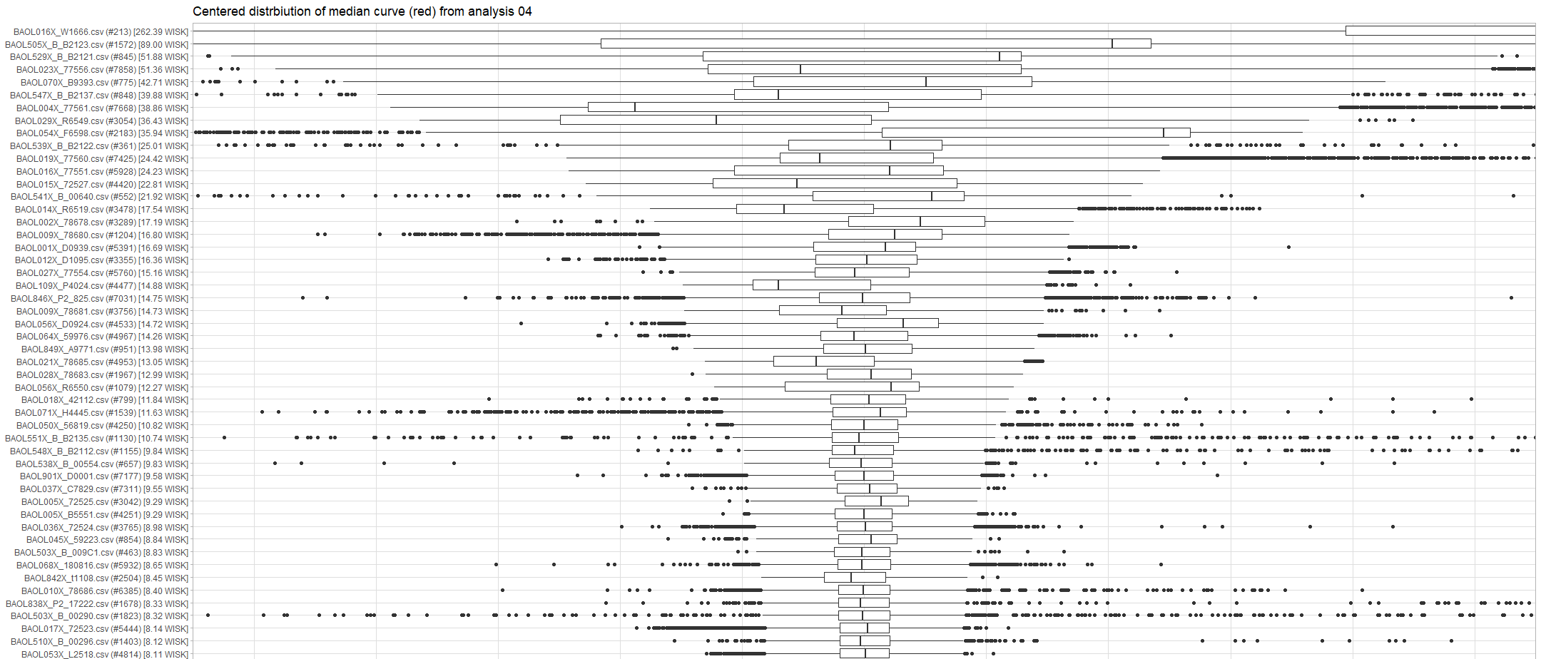
Overview Multi comparison overview based on IQR range

Slide 14
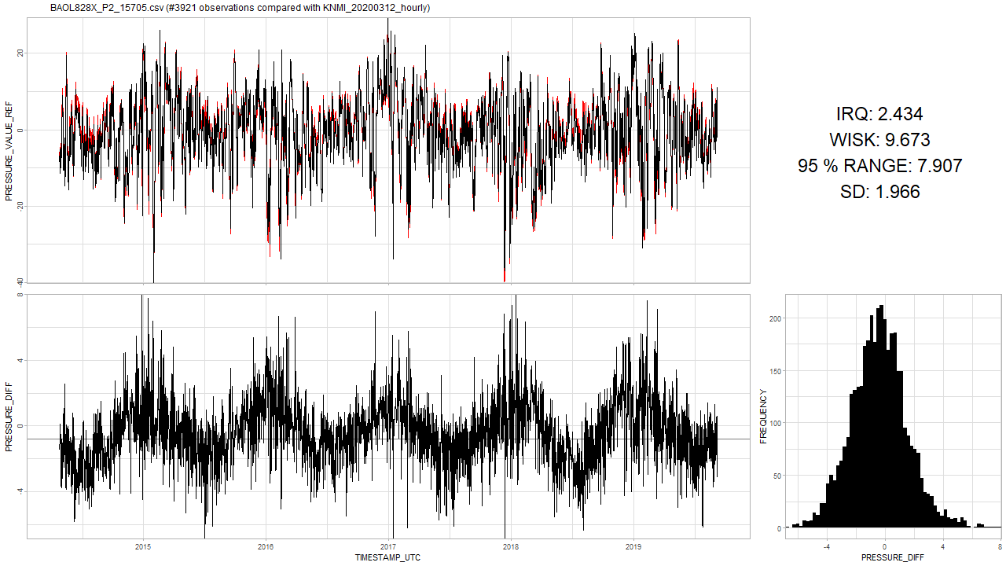
Seasonality in timeseries? Cf. WMO-No. 8: Guide to Instruments
“Most instruments measure temperature to compensate its effect.”
Electronic barometers
Capacitive sensors: diaphragm changing the capacitor → temperature dependent
Piezoresistive → can be made temperature independent and immune to hysteresis
Cylindrical resonator → temperature dependent
Aneroid (= “without fluid”) displacement: vs hydrostatic gauges → temperature dependent
“In order to maintain the acceptable performance of a barometer, the calibration corrections applied to the readings must be checked at relatively frequent intervals, for example, starting annually, for early detection and replacement of defective instruments.”

Slide 15
Barometer altitude analysis

Slide 16
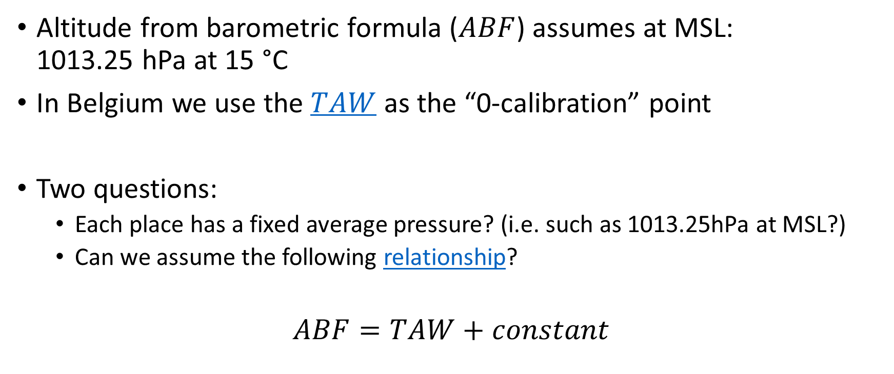
Barometer altitude analysis
Altitude from barometric formula ($ABF$) assumes at MSL: 1013.25 hPa at 15 °C
In Belgium we use the $TAW$ as the “0-calibration” point
Two questions:
Each place has a fixed average pressure? (i.e. such as 1013.25hPa at MSL?)
Can we assume the following relationship?
$$ABF=TAW+constant$$
Notes:
Note that in the barometric formula the assumption is that MSL is at 1013.25 hPa and 15 °C, In Belgium we use TAW as the MSL. So although we all use the same pressure reduction techniques, the "0-calibration point" is not necessarily the same.

Slide 17
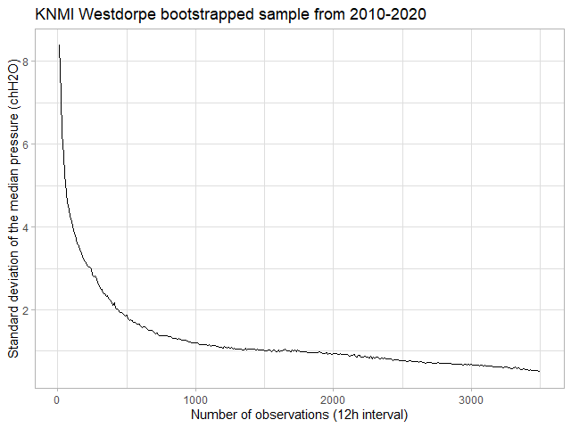
Barometer altitude analysis Fixed average pressure can be measured correctly?

Slide 18
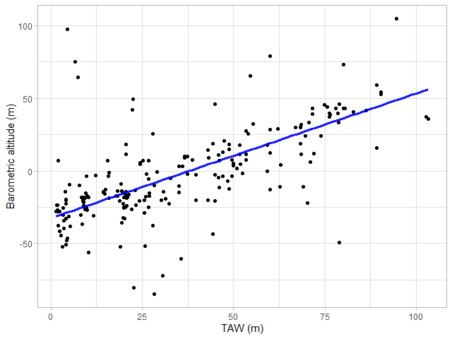
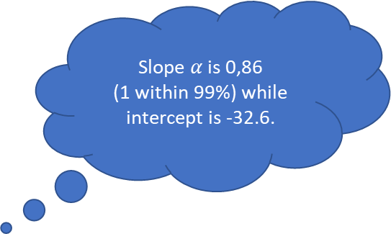
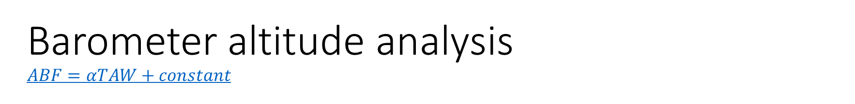
Barometer altitude analysis $$ABF=αTAW+constant$$
Slope $α$ is 0,86 (1 within 99%) while intercept is -32.6.

Slide 19
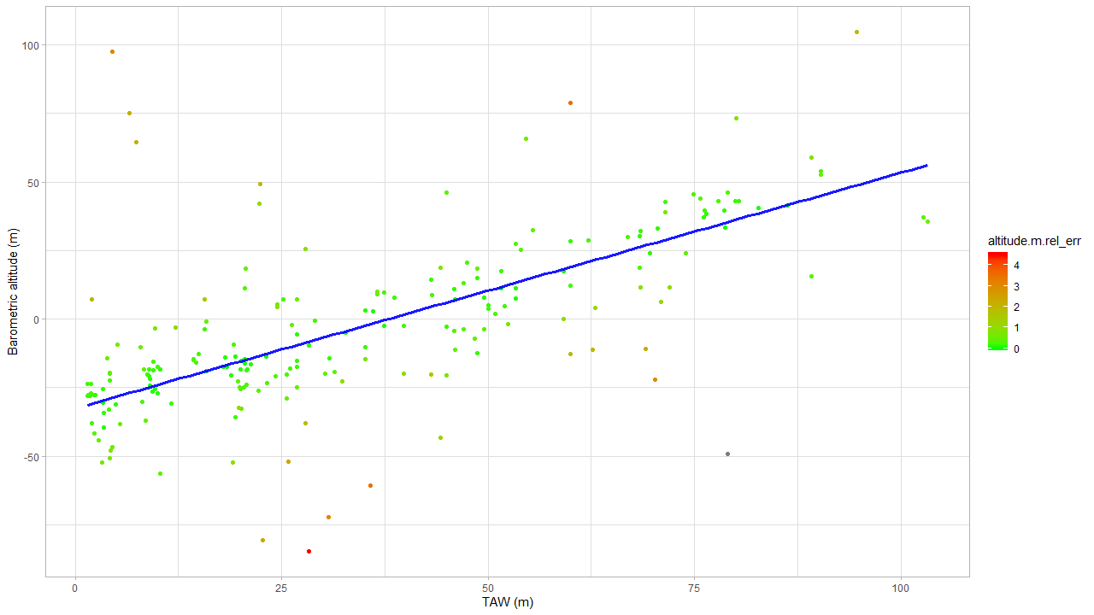

Barometer altitude analysis $$ABF=αTAW+constant$$
Not enough data: no evidence that broken.
Relative error: amount of data taken into consideration.
Barometer offset problem?

Slide 20
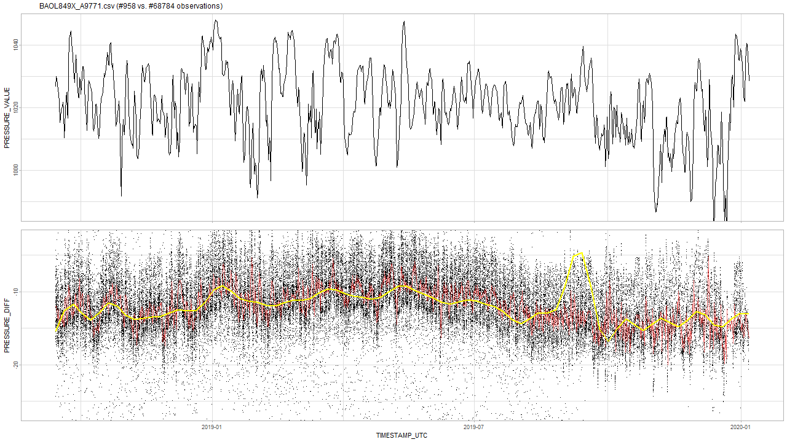
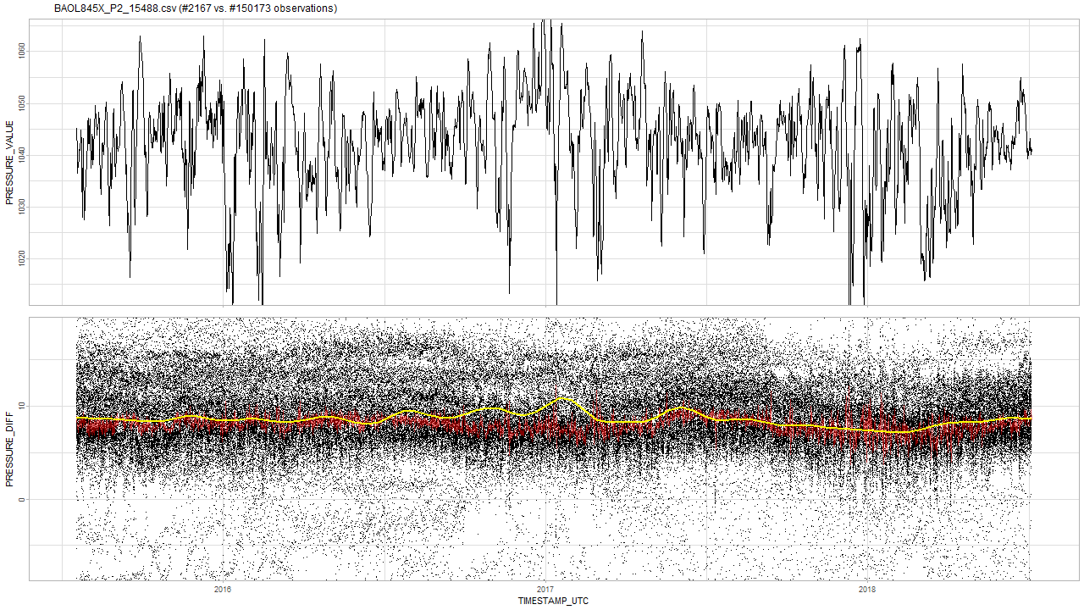
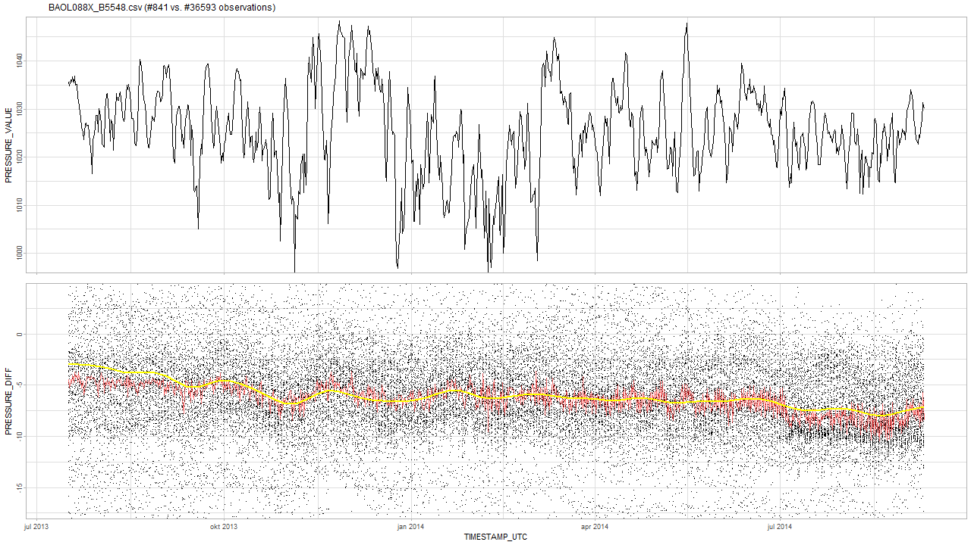
Barometer altitude analysis $$ABF=αTAW+constant$$
logger N altitude.m.bf RASTERVALU altitude.m.rel_err
1: barodata/BAOL015X_72527.csv 4420 -84.582470 28.29 4.495663
2: barodata/BAOL109X_P4024.csv 4477 78.818297 60.00 3.525451
3: barodata/BAOL004X_77561.csv 7667 -60.749429 35.72 3.467790
4: barodata/BAOL849X_A9771.csv 958 97.650572 4.45 3.068416 ***
5: barodata/BAOL029X_R6549.csv 3054 -72.348491 30.65 3.038848
6: barodata/BAOL019X_77560.csv 7425 -22.046760 70.25 2.936357
7: barodata/BAOL014X_R6519.csv 3478 -51.858903 25.82 2.395642
8: barodata/BAOL845X_P2_15488.csv 2167 -80.559779 22.67 2.279869 ***
9: barodata/BAOL027X_77554.csv 6065 -10.962409 69.11 2.225562
10: barodata/BAOL070X_B9393.csv 775 75.014820 6.59 2.220084 ***
11: barodata/BAOL088X_B5548.csv 841 64.536759 7.39 2.068103 ***
12: barodata/BAOL012X_D1095.csv 3355 7.058513 1.96 1.973851
13: barodata/BAOL093X_78679.csv 4396 -11.125500 62.70 1.910527 ***
14: barodata/BAOL064X_59976.csv 4967 -12.756265 59.96 1.867836
15: barodata/BAOL054X_F6598.csv 2165 104.657061 94.64 1.847558
16: barodata/BAOL071X_H4445.csv 1539 49.146993 22.42 1.794395 ***
17: barodata/BAOL009X_78681.csv 4023 -37.837886 27.89 1.721346
18: barodata/BAOL001X_D0939.csv 5391 7.197382 15.63 1.552928
Notes:
So although these barometers do not drift, their median pressures seem to be way off from what we expect, so I would advise to double-check them.

Slide 21
Next steps
detect_drift()

Slide 22
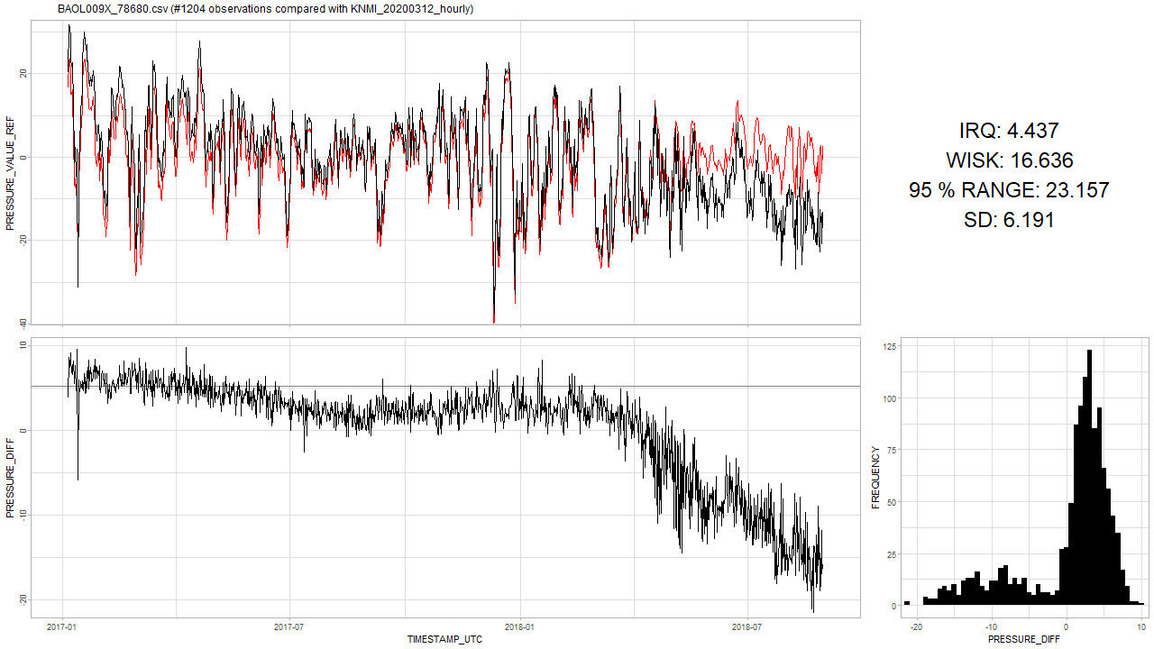
Next steps detect_drift()
Based on “Multi or Reference comparison” analysis.
Output should divide the timeseries in FALSE and TRUE (= drift)

Slide 23
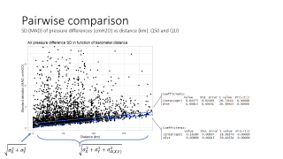
Next steps detect_drift()
Interface
detect_drift(x)
Probably the least precise: only information supplied is the time series of a barometer.
detect_drift(x, reference)
Based on reference comparison analysis:
Reference should be a good non-drifting barometer.
Reference should span the whole time-frame of x.
The larger the distance, the less accurate the results. (cf. “each 100km the error is 2 cmH2O due to distance”)
detect_drift(x, other)
Based on multi comparison analysis:
Need most of the other barometers to make a comparison and thus detect drift.
Probably the most precise (not yet confirmed).

Slide 24
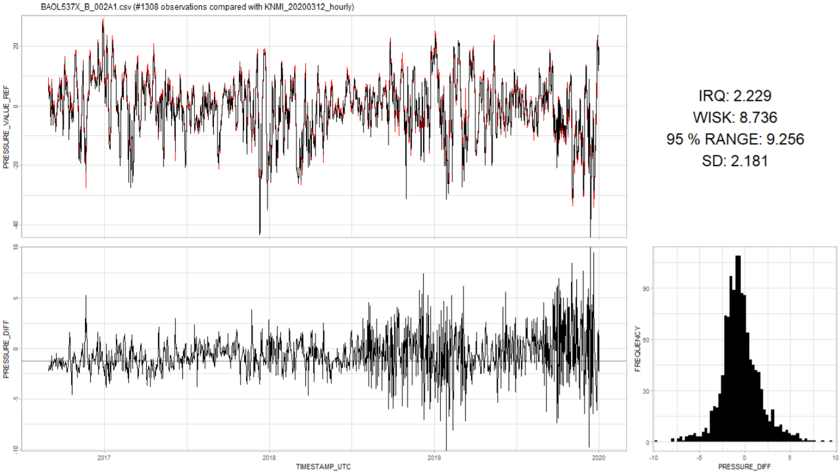
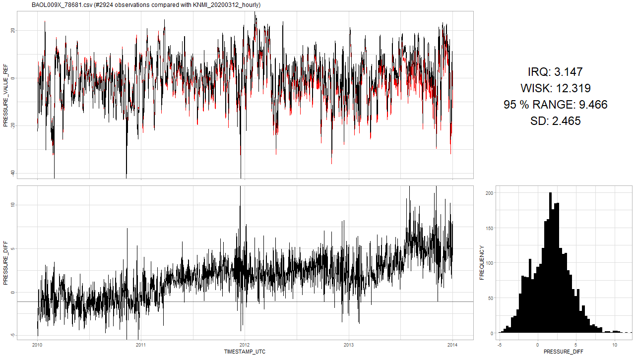
Next steps detect_drift()
Most of the analysis up till now was based on the variance of differences between one barometer vs. all/reference.
Hysteresis is indistinguishable from drift based on variance alone:
Notes:
Similar variance numbers

Slide 25
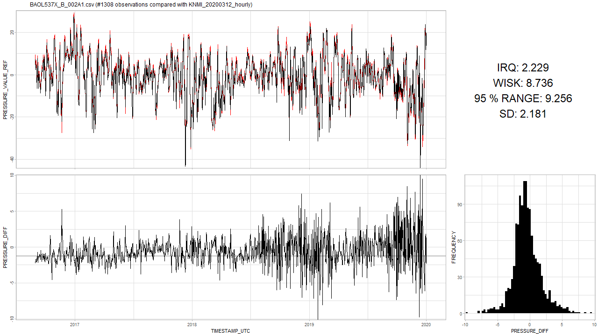

Next steps detect_drift()
Based on “Multi or Reference comparison” analysis.

Slide 26
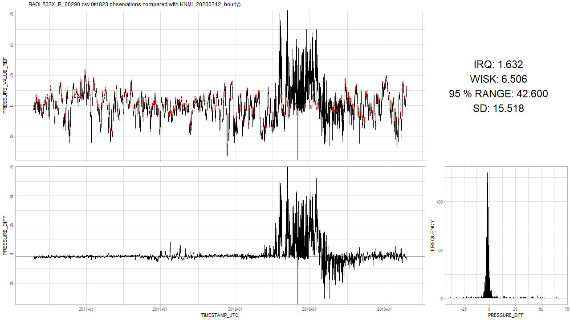
Next steps detect_drift()
Might cause trouble for an algorithm.
And then there is the occasional trouble:

Slide 27
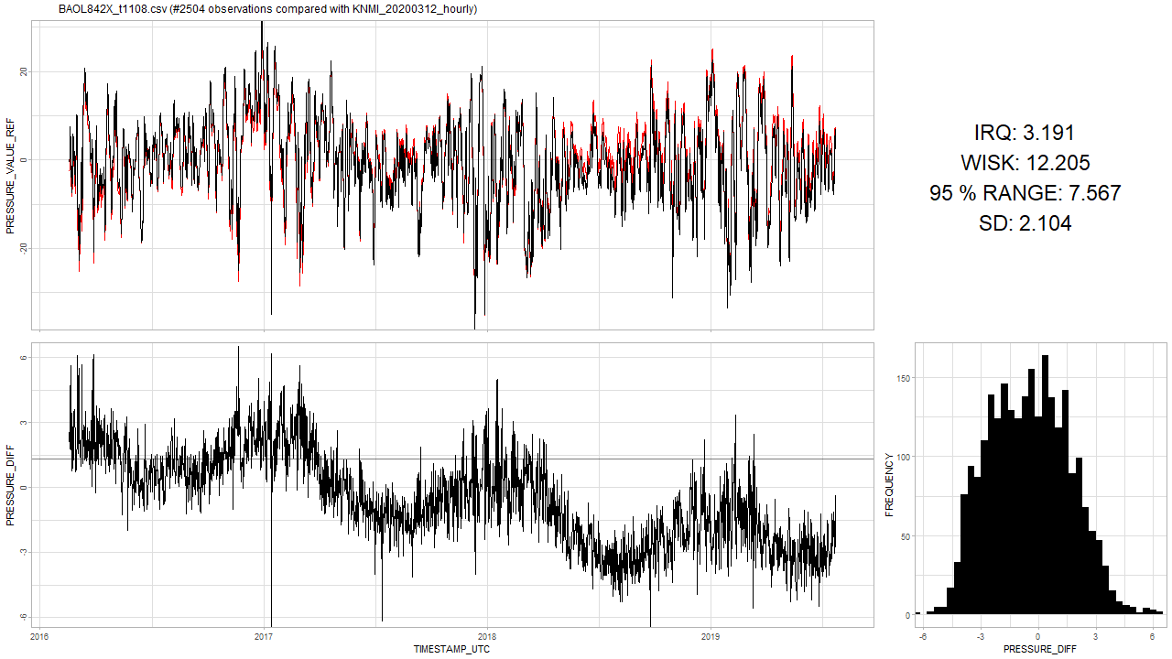
Next steps detect_drift()
Detecting up- or down-ward movement is tricky and in the starting phase, will mainly depend on how much new data on has.
When should the algorithm say that this one started drifting?
I think the algorithm should first detect seasonality, and then later a drift.
Notes:
Similar variance numbers

Slide 28
Next steps detect_drift()
A first tryout on the algorithm that can detect drifts?
Design
Implementation
Assessment
Analysis on the seasonality pattern:
Specific frequency (i.e. yearly) or multiple frequencies?
Notes:
Similar variance numbers

Slide 29
The End

Slide 30
Sprint 7
Analysis: drifts in air pressure

Slide 31
Agenda
Air pressure data analysis
Altitude
Temperature
Humidity
Barometer drift detection
Pairwise difference model
Multi difference model
Next steps
Questions

Slide 32
Air pressure modeling
Theory and data analysis

Slide 33
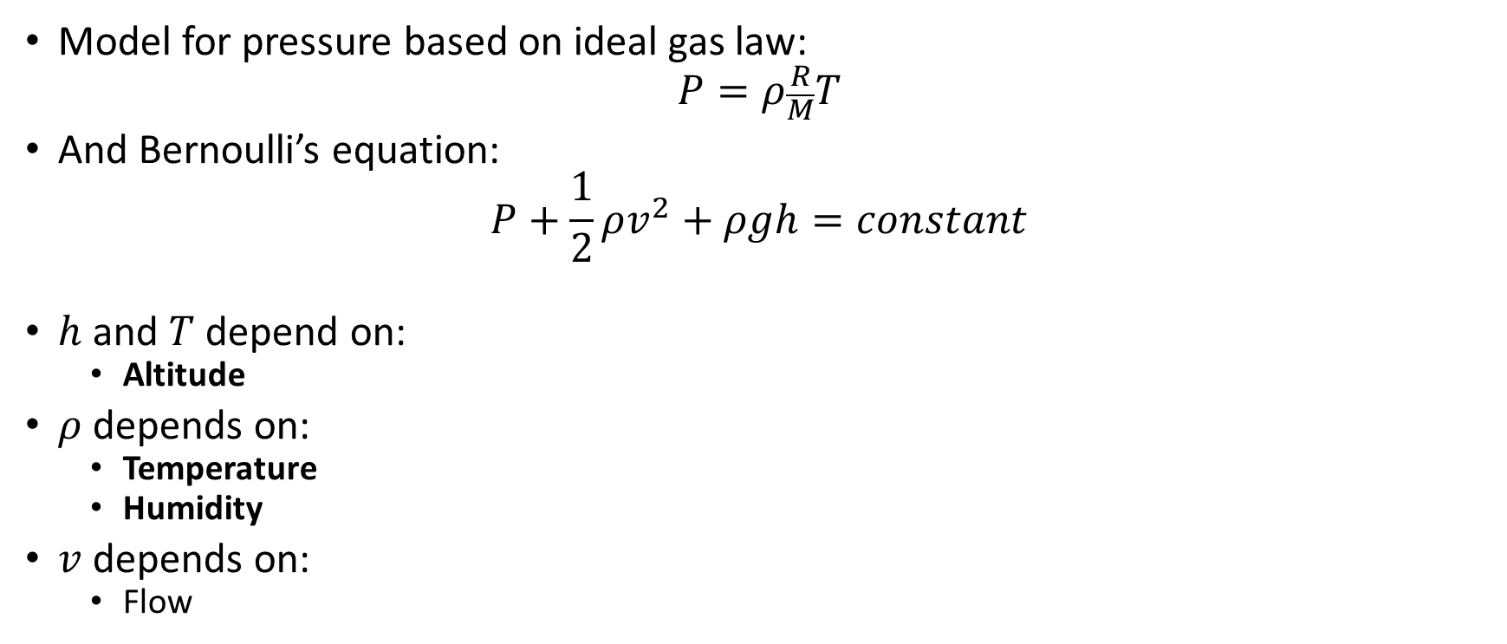
Air pressure
Model for pressure based on ideal gas law:
$$P=ρ\frac{R}{M}T$$
And Bernoulli’s equation:
$$P+\frac{1}{2}ρv^{2}+ρgh=constant$$
$h$ and $T$ depend on:
Altitude
$ρ$ depends on:
Temperature
Humidity
$v$ depends on:
Flow

Slide 34
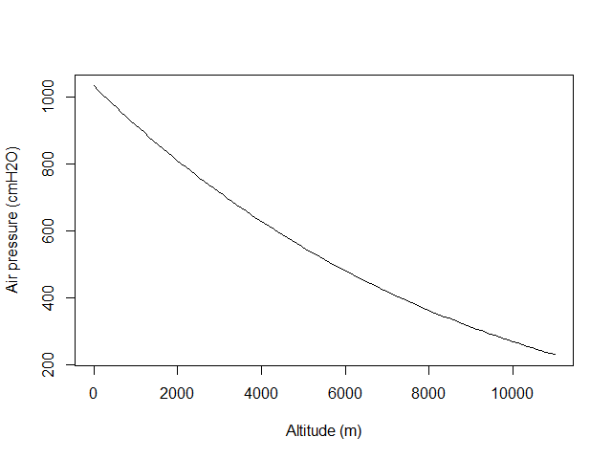
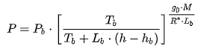
Altitude Barometric formula
Around sea-level, an increase of 100 m in altitude corresponds to a decrease of 12 cmH2O in air pressure.
Notes:
https://en.wikipedia.org/wiki/Barometric_formula#Derivation

Slide 35
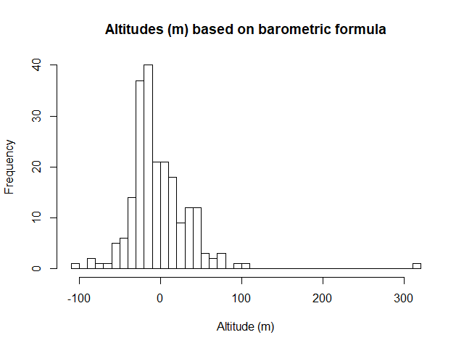
Altitude Barometric formula
Notes:
https://en.wikipedia.org/wiki/Barometric_formula

Slide 36
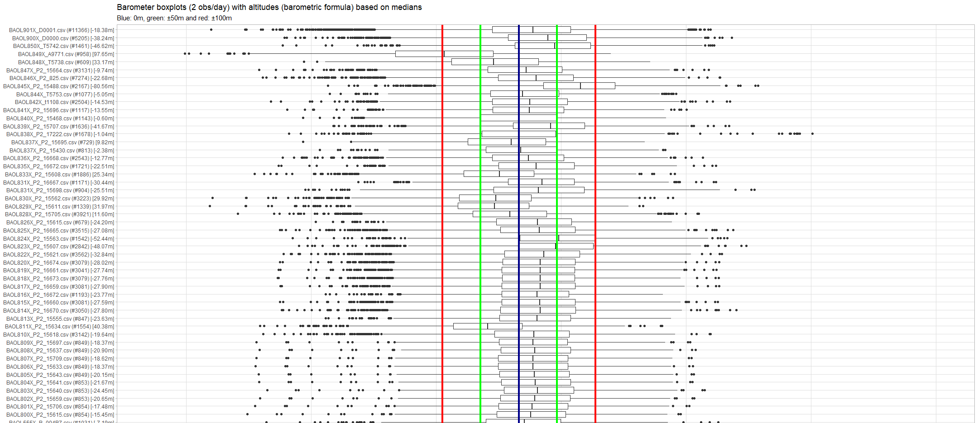
Altitude Barometric formula
Notes:
https://en.wikipedia.org/wiki/Barometric_formula

Slide 37
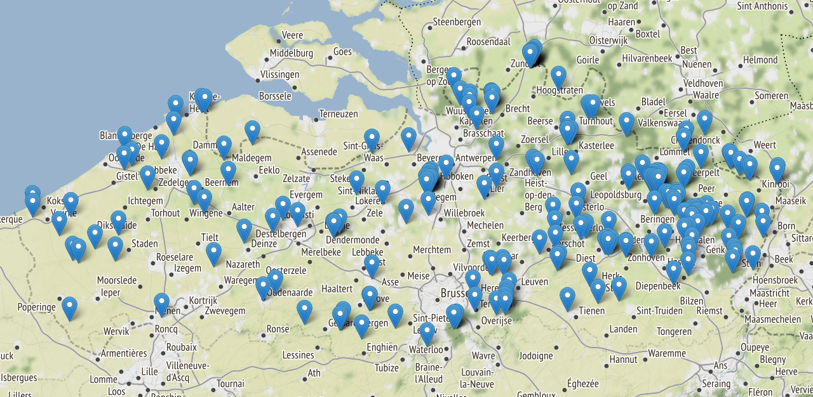
Barometer altitude
Notes:
Can be extracted with e.g. Google Elevation API for comparison.

Slide 38
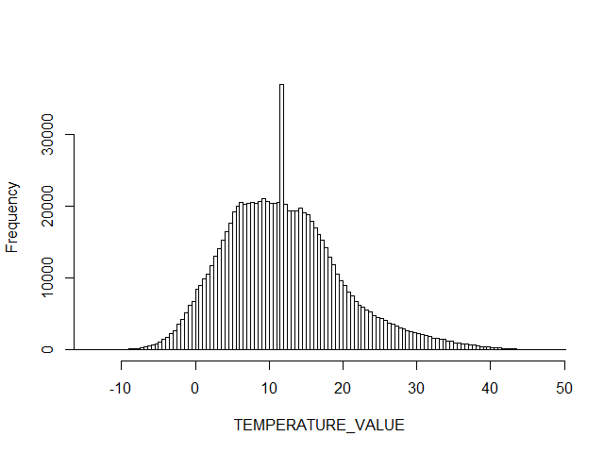
Temperature Data analysis
Temperature distribution of all barometers.

Slide 39
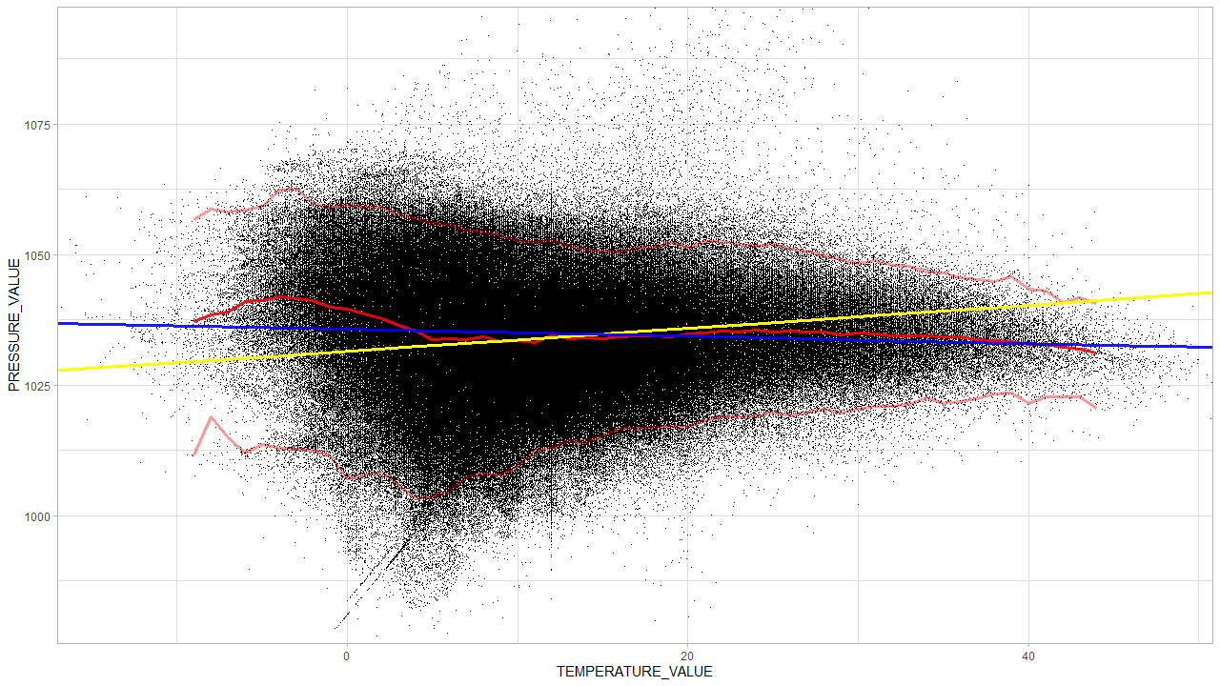
Temperature Data analysis
Raw data: BAOL016X_W1666.csv and BAOL050X_56819.csv excluded.
Notes:
Blue line is the median regression.

Slide 40
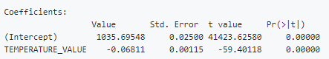
Temperature Data analysis
Notes:
Blue line is the median regression. Yellow is OLS: might be influenced by outliers.

Slide 41

Temperature Theory
$$P=ρ\frac{R}{M}T$$
Both $ρ$ and $T$ are unknown (and interdependent)
We have only one equation
For discussion, see here
Theoretical effect of local temperature change on air pressure unknown. More research needed.

Slide 42
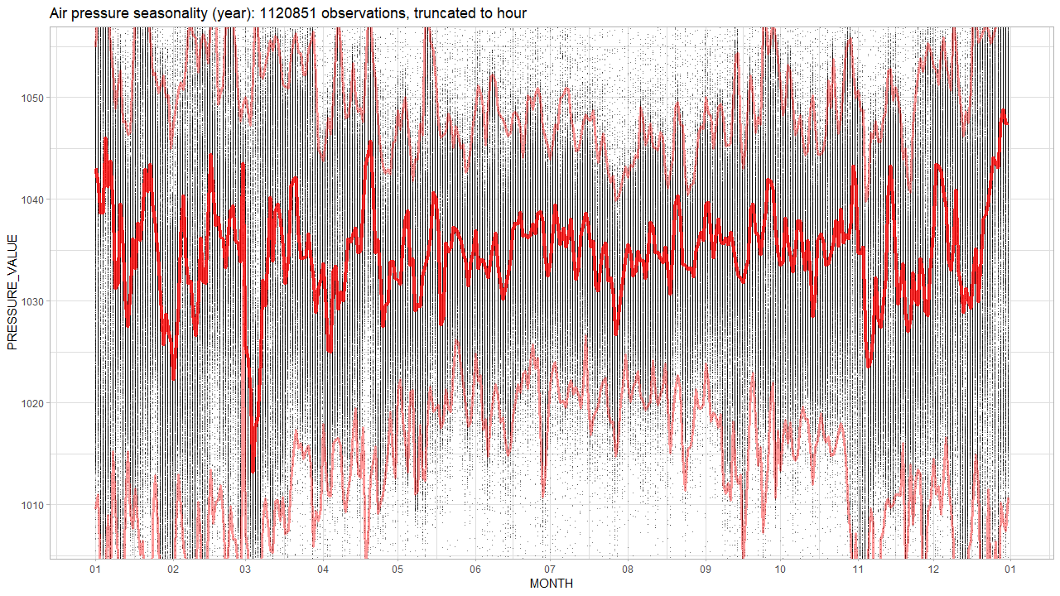
Temperature Data analysis
The bulge? Seasonal?
Notes:
Blue line is the median regression.

Slide 43
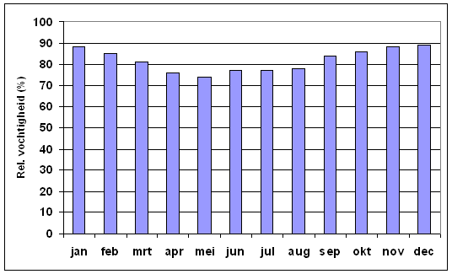
Humidity Data analysis
Bulge due to high humidity?

Slide 44
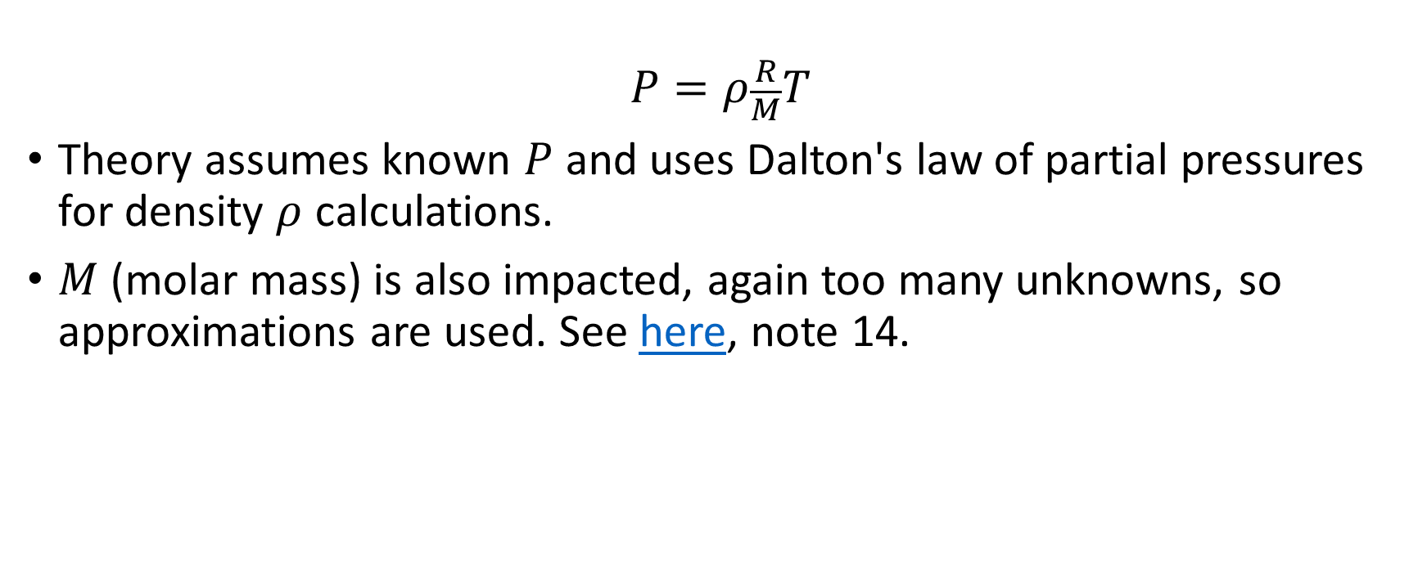
Humidity Theory
$$P=ρ\frac{R}{M}T$$
Theory assumes known $P$ and uses Dalton's law of partial pressures for density $ρ$ calculations.
$M$ (molar mass) is also impacted, again too many unknowns, so approximations are used. See here, note 14.
Theoretical effect of humidity on air pressure unknown. More research needed.

Slide 45
Summary
Altitude
Effect is significant: 12 cmH2O per 100m.
Temperature: effect unknown
Data analysis suggests 0,07 cmH2O drop per 1 °C. Over the observed range [-10, 50] °C this amounts to 4 cmH2O change.
Humidity: effect unknown
Seasonality analysis shows humidity has no impact on mean air pressure.
Humidity might be causing more lower pressure observations during non-summer time. (i.e. the bulge around 5 °C)

Slide 46
Barometer drift analysis
Theory and results

Slide 47

Ideal situation: 2 barometers side by side
$X_{t}=μ_{t}+ε_{X}$ and $Y_{t}=μ_{t}+ε_{Y}$
Subtract yields:
$$X_{t}−Y_{t}=ε_{X}−ε_{Y}=ε_{XY}∼N(0, σ_{X}^{2}+σ_{Y}^{2})$$
Notes:
Neem aan dat epsilons normal verdeeld zijn.

Slide 48
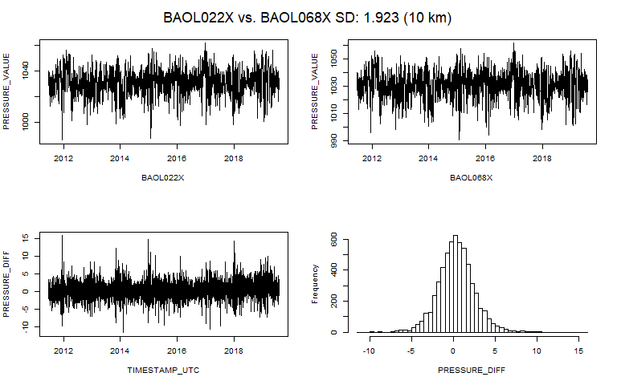
Pairwise comparison Two barometers close to each other.
At 11m and 13m altitude? So differences are white noise around 0 cmH2O.
Notes:
At 11m and 13m altitude.

Slide 49
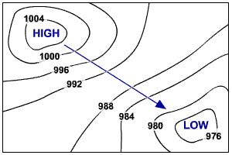

Situation: 2 barometers at a distance
$$X_{t}=μ_{t}+ε_{X}$$
and
$$Y_{t}=μ_{t}+ε_{Y}+ε_{d(X,Y)}$$
Subtract yields:
$$X_{t}−Y_{t}=ε_{XY}+ε_{d(X,Y)}$$
$$∼N(0, {σ_{X}^{2}+σ_{Y}^{2}+σ}_{ d(X,Y)}^{2})$$

Slide 50
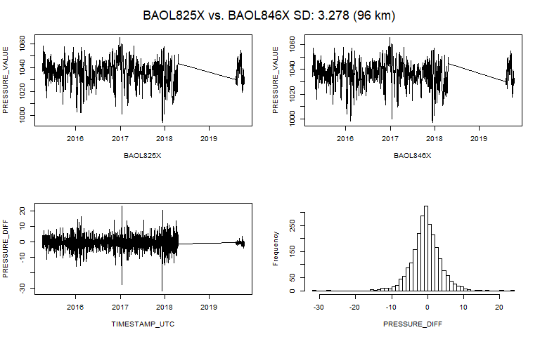
Pairwise comparison Two barometers close to each other.
At -27m and -23m altitude? So differences are white noise around 0 cmH2O.

Slide 51
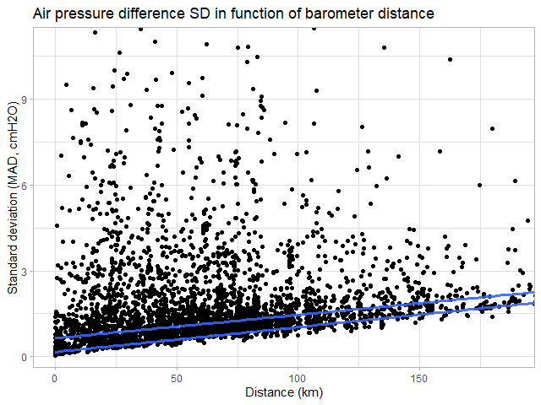
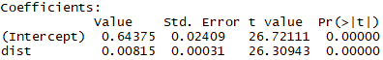
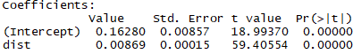
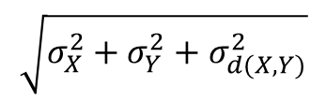
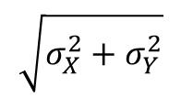
Pairwise comparison SD (MAD) of pressure differences (cmH2O) vs distance (km): Q50 and Q10
$$\sqrt{σ_{X}^{2}+σ_{Y}^{2}}$$
$$\sqrt{σ_{X}^{2}+σ_{Y}^{2}+σ_{d(X,Y)}^{2}}$$

Slide 52
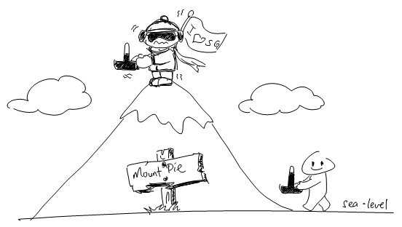
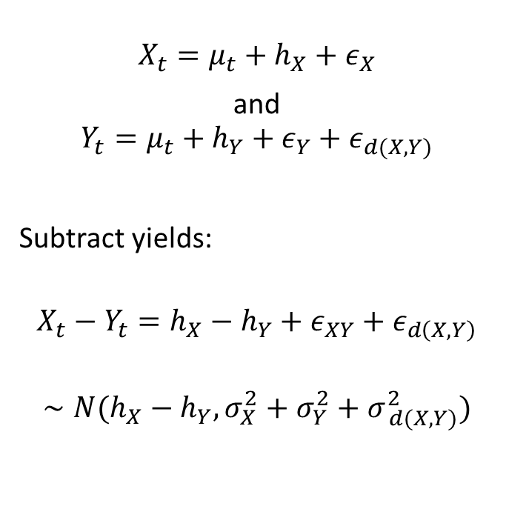
Situation: 2 barometers at a distance and different altitude
$$X_{t}=μ_{t}+h_{X}+ε_{X}$$
and
$$Y_{t}=μ_{t}+h_{Y}+ε_{Y}+ε_{d(X,Y)}$$
Subtract yields:
$$X_{t}−Y_{t}=h_{X}−h_{Y}+ε_{XY}+ε_{d\left(X,Y\right)}$$
$$∼N(h_{X}−h_{Y}, {σ_{X}^{2}+σ_{Y}^{2}+σ}_{ d(X,Y)}^{2})$$

Slide 53

Pairwise comparison Two barometers far from each other.
At -32m and 13m altitude? So differences are white noise around 6 cmH20.

Slide 54

Pairwise comparison Two barometers while one drifting: high SD
Very high SD due to drift.
Notes:
Als nodig, dan kan ik die plots nog verbeteren… want in analyse 02 is matching niet optimaal.

Slide 55





Pairwise comparison Problems

Slide 56
Pairwise comparison Conclusion
They do not tell us which one is drifting,
If they both drift the same way, we do not even see it.

Slide 57

Situation: multiple barometers at a distance and different altitude
$$X_{t}=μ_{t}+h_{X}+ε_{X}$$
and
$$Y_{i,t}=μ_{t}+h_{Y_{i}}+ε_{Y_{i}}+ε_{d(X,Y_{i})} Y_{i}∈ℬ ∖ X$$
Subtract yields:
$X_{t}−Y_{1,t}=h_{X}−h_{Y_{1}}+ε_{XY}+ε_{t, d\left(X,Y_{1}\right)}$ $∼N(h_{X}−h_{Y_{1}}, {σ_{X}^{2}+σ_{Y_{1}}^{2}+σ}_{ d(X,Y_{1})}^{2})$
$X_{t}−Y_{2,t}=h_{X}−h_{Y_{2}}+ε_{XY}+ε_{t, d\left(X,Y_{2}\right)}$ $∼N(h_{X}−h_{Y_{2}}, {σ_{X}^{2}+σ_{Y_{2}}^{2}+σ}_{ d(X,Y_{2})}^{2})$
$$⋮$$
$X_{t}−Y_{n,t}=h_{X}−h_{Y_{n}}+ε_{XY}+ε_{t, d\left(X,Y_{n}\right)}$ $∼N(h_{X}−h_{Y_{n}}, {σ_{X}^{2}+σ_{Y_{n}}^{2}+σ}_{ d(X,Y_{n})}^{2})$
Notes:
Als hier nu een paar Yi fout zijn, maar de meeste Yi juist zijn, dan zouden die paar foute geen al te grote

Slide 58

Multi comparison One barometer vs all the rest

Slide 59

Multi comparison One barometer vs all the rest

Slide 60

Multi comparison One barometer vs all the rest

Slide 61
Multi comparison One barometer vs all the rest

Slide 62

Multi comparison One barometer vs all the rest

Slide 63

Multi comparison One barometer vs all the rest
Temperature pattern in blue: positively correlated.

Slide 64

Multi comparison One barometer vs all the rest
You never see barometers first oscillating and then stabilizing.
Notes:
Feit dat ze altijd naar het einde toe oscilleren weerlegt een mogelijk argument dat de baro’s in andere tijdenlijk andere weeromstandigheden staan.

Slide 65

Multi comparison One barometer vs all the rest

Slide 66

Multi comparison One barometer vs all the rest
Temperature pattern in blue: negatively correlated.

Slide 67

Multi comparison One barometer vs all the rest

Slide 68

Multi comparison One barometer vs all the rest

Slide 69

Multi comparison One barometer vs all the rest
Sometimes negative, sometimes positive correlation?

Slide 70

Multi comparison One barometer vs all the rest
Temperature peaks not in sync at the end.

Slide 71

Multi comparison One barometer vs all the rest
This one is still good.

Slide 72

Multi comparison One barometer vs all the rest

Slide 73

Multi comparison One barometer vs all the rest

Slide 74

Multi comparison One barometer vs all the rest
Old but also still good.

Slide 75

Multi comparison One barometer vs all the rest

Slide 76

Multi comparison One barometer vs all the rest

Slide 77

Multi comparison One barometer vs all the rest

Slide 78

Multi comparison One barometer vs all the rest

Slide 79

Multi comparison One barometer vs all the rest

Slide 80

Multi comparison One barometer vs all the rest

Slide 81

Multi comparison One barometer vs all the rest
Very old but still “OK”? The oscillations are not all that big. Why?

Slide 82

Multi comparison One barometer vs all the rest

Slide 83

Multi comparison One barometer vs all the rest

Slide 84

Multi comparison One barometer vs all the rest
Where will it end?

Slide 85

Multi comparison One barometer vs all the rest
What happened?

Slide 86

Multi comparison One barometer vs all the rest
Calibration test could verify this one is too low currently?

Slide 87

Multi comparison One barometer vs all the rest
This one “was” new? Now unstable?

Slide 88

Multi comparison One barometer vs all the rest
Unstable?

Slide 89

Multi comparison One barometer vs all the rest
Unstable?

Slide 90

Multi comparison One barometer vs all the rest
Unstable?

Slide 91

Multi comparison One barometer vs all the rest
Unstable?

Slide 92

Multi comparison One barometer vs all the rest
Unstable?

Slide 93

Multi comparison: remarks
Universal way of matching barometers on timestamps.
Truncation: 12h
E.g. observation at 2019-02-02 13:05:00 UTC is truncated to 2019-02-02 12:00:00 UTC
Averaging over truncated values.
Missing values for barometers are a potential problem.
E.g. for 2020, if there is no barometers available for comparison, or if there is only a limited number of barometers available?
Seems many barometers become sensitive to temperature changes after x years?
No clear temperature dependence pattern.
Many barometers seem broken? Median assumes about 50 % non-broken.
After BAOL1XX less drifting cases but more unstable cases?
Some are just unstable? (i.e. not drifting)
Mostly BAOL5XX

Slide 94

Next steps
Continue “multi-comparison” analysis?
Try removing altitude-effect for better comparison? (e.g. remove $h_{X}$ and $h_{Y}$)
Compare altitudes based on barometric formula with real elevation based on the coordinates
…?
First algorithm: detect trend $α≠0$ for some structural break at $t_{b}$ for model $y=c+αtI\left(t>t_{b}\right)+ε$
detect_drifts(x, other)
Need enough “other” data to compute “x”. Problem: what is enough?
Detect any significant change in trend $α$ after $t_{b}$.
detect_drifts(x)
Can be based on apriori data about $α$. If trend $α$ is larger than the worst case in apriori data, then flag from $t_{b}$.
detect_drifts(x, altitude)
…?

Slide 95

Next steps: potential problems
How certain are we that barometers from analysis 04 are broken?
Need a validated set of drifting and non-drifting barometers to make comparisons of algorithms.
Unstable barometers: detecting change after $t_{b}$ with $α≠0$ is difficult.

Slide 96



Questions?
Frederic: question from GitHub solved?
Frederic: “Typically one Barologger can cover a radius of 30 km (20 mile) and/or every 300 m (1000 ft) elevation change.”
Radius 30 km: error SD increase with 0,3 cmH2O (analysis)
Elevation change of 300 m: 36 cmH2O change in mean (barometric formula)
Piet: hydrostatic error: 2 cmH2O.
For baro’s from analysis of median: 1,3 cmH2O
After about 100km the error is also 2 cmH20 due to distance.
Piet: -20 tot 50 °C: effect?
Effect based on analysis: 70 * 0,068 = 4,8 cmH2O

Slide 97
The End

